Slide 1
CoderLab
Jake Bertram
Erich Kuerschner
Bryan Passini
Dan Smith
Kyle Tietz
Jacob Wallraff
Advisor and Client: Joe Zambreno

Slide 2
Instructor-Student Learning - Code
Often, learning code in lectures is a one-way experience
Instructors explain concepts
Students learn methods through lab
CoderLab provides a collaborative coding experience
Students can actively code and receive feedback in class or recitation
Notes:
Mention typical use-case
Dan Smith

Slide 3
Scope of the Project
A collaborative browser-based code editor with the classroom in mind
Collaboration in real time
Compile and run code
Student-oriented, instructor-controlled
Interactive
Notes:
Different user types (instructor vs students) greatly increases the scope: just something to mention at that bullet point’
Jake B

Slide 4
What We are Developing
Web server
Frontend web page
Docker container manager
Notes:
Jake B

Slide 5
Design Evolution
In our first semester, we proposed a number of features
Developed proofs of concept for features
Received feedback from our client ideas
Revised the design to incorporate new features
Notes:
Bryan P

Slide 6
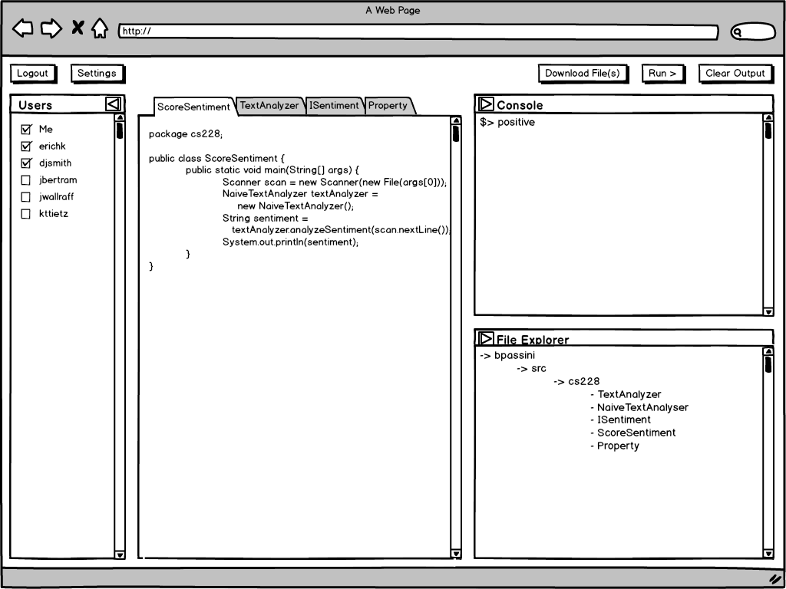
Notes:
Bryan P

Slide 7
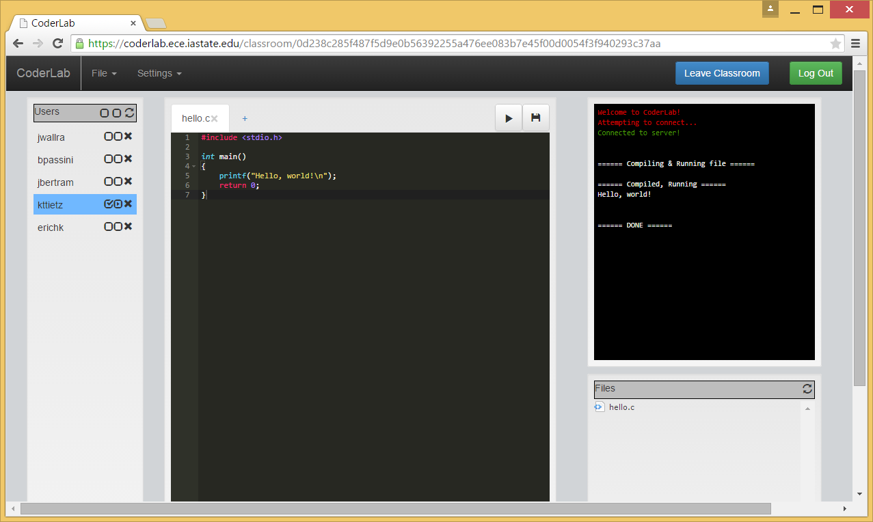
Notes:
Bryan P

Slide 8
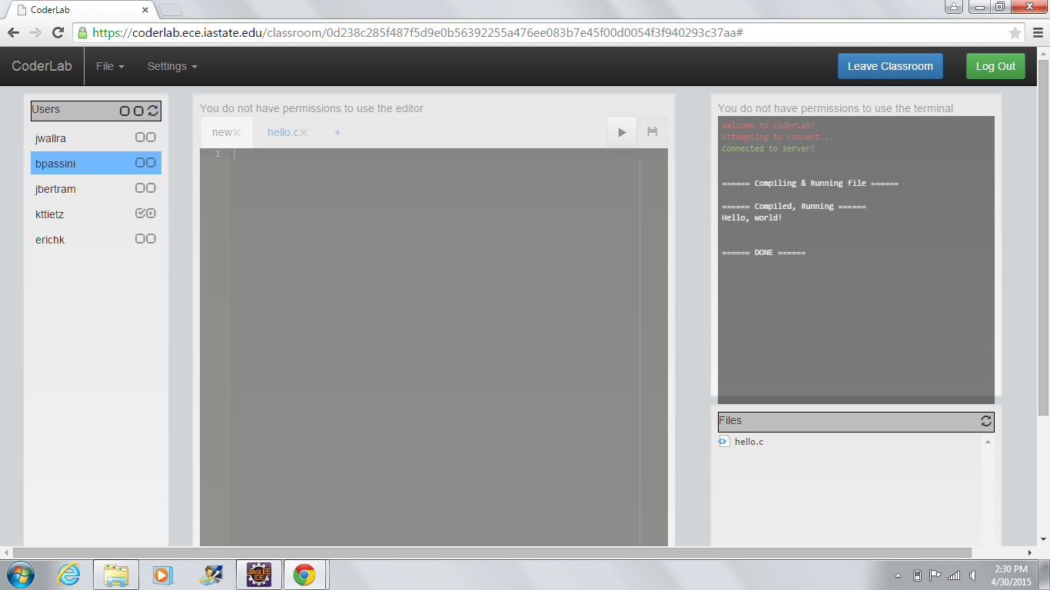
Notes:
Bryan P

Slide 9
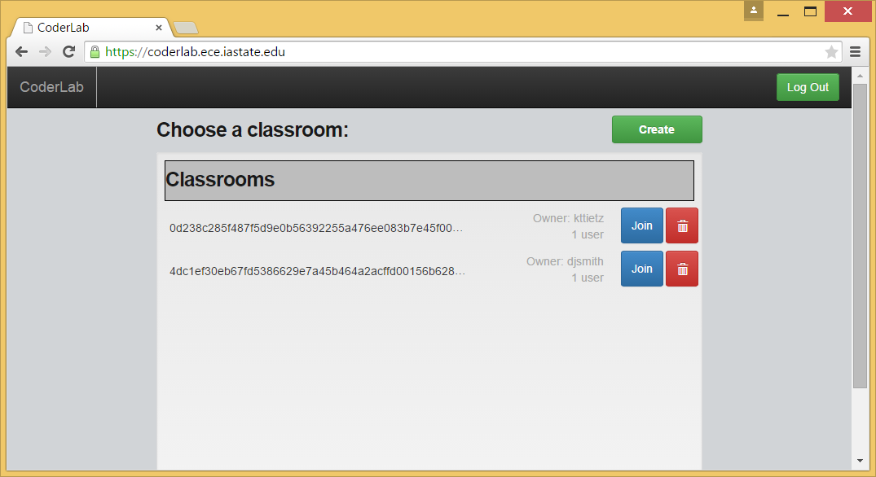
Notes:
Bryan P

Slide 10
Current Design

Slide 11
Current Design - Docker
Makes use of linux kernel features for OS-level virtualization
Kernel namespaces isolate the view of process trees and their resources
cgroups manage resource allocations for process trees
The result:
Multiple userlands running on the same OS, isolated from each other
Known as containers
Notes:
Containerization: keep a system’s process trees and resources in complete isolation
Docker - manages containers
Allows packaging up an environment that may be reused and disposed of
This is the basis of our classroom container concept
Jake B

Slide 12
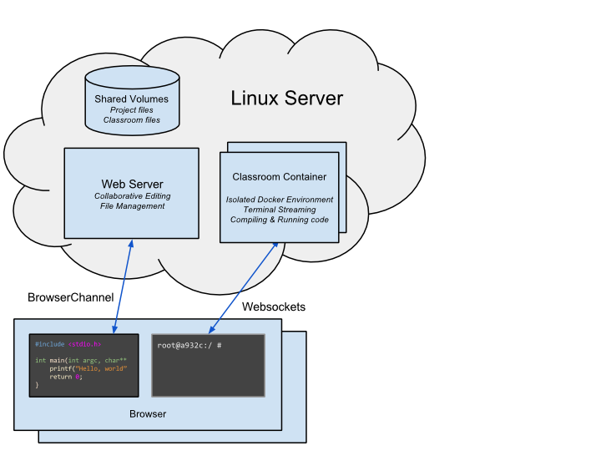
Current Design - Docker
“Classrooms” are containers that house files and isolated processes
Classroom containers are managed by Docker
Hosts a node.js server to provide interactive terminal and code compilation
Communicates with client-side via websockets
Connected to server through shared directory with the host
Notes:
Jake B

Slide 13
Current Design - File Editor
Multi-tab Ace editor
Syntax highlighting for several programming languages
Smart tabbing
Allows for collaboration on shared documents
Notes:
biggest component is the file editor
we used the ace plugin which allows for stylish editing of code with support for syntax highlighting for several programming languages
we also use some custom logic to make navigating through the various tabs in the editor easier
-tabs which the admin has open are automatically opened when users join the session
-tabs that the admin open are also opened for the other users -> allows for a guided experience
we chose ace over competitors because of its ease in integrating with shareJS
Erich K

Slide 14
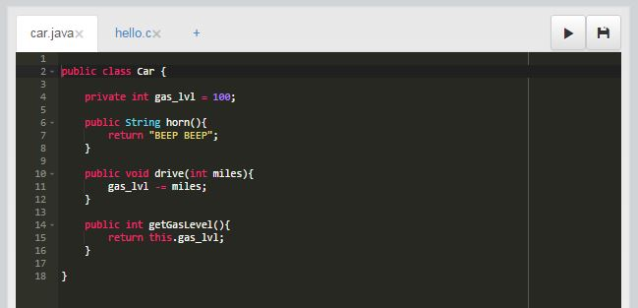
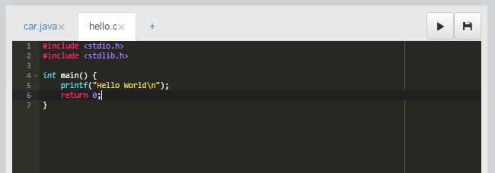
Notes:
Erich K

Slide 15
Current Design - Collaboration
ShareJS library
Uses Operational Transforms
Ensures eventual consistency between clients
Collaborative documents are held in memory
differs from actual files located on disk
Notes:
Erich K

Slide 16
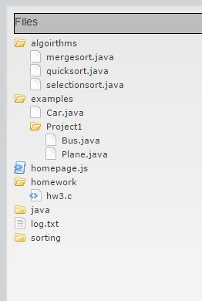
Current Design - File System
Users can browse, create and edit files specific to their Docker classroom
Asynchronously retrieves file and subdirectory data from the classroom’s own file mount in the Docker container
Displays file system using jQuery FileTree plugin
Notes:
according to our requirements we developed a file system which allows users to create and edit files shared by many users
file systems are specific to the classroom to avoid overwriting material
Classrooms have their own isolated file system mounted to a directory in the Docker container
Erich K

Slide 17
Current Design - Permissions
Two user types
Admin has all permissions
Other users assigned editor or shell permissions
Users without permissions have read-only access
Notes:
mutliple user types added to the complexity/scope of the project
the admin (room creater) who starts the instance of CoderLab has all permissions
permissions include the ability to edit documents and save files and run commands in the shell
the admin can assign or revoke permissions to other users (likely students) as they join the session
users with no permissions will not be able to write to editor or the shell but can still run files
Kyle T
frontend (disabled elements) and backend authentication check for writing to files and share docs

Slide 18
Current Design - Terminal
Term.js
Javascript xterm clone
Pty.js
Shell process forking utility
WebSockets
Connects client terminal emulator to server shell process
Notes:
Dan Smith
xterm is a terminal emulator. Term.js displays data received from the shell and provides an interface for the user to type and send character codes.
pty.js creates a shell process that the server can bind to for sending and receiving data
WebSockets are used to establish a connection between the client interface and the server shell
Users type into the terminal, characters are sent to the shell process, and updates are broadcast to the other users in the same room

Slide 19
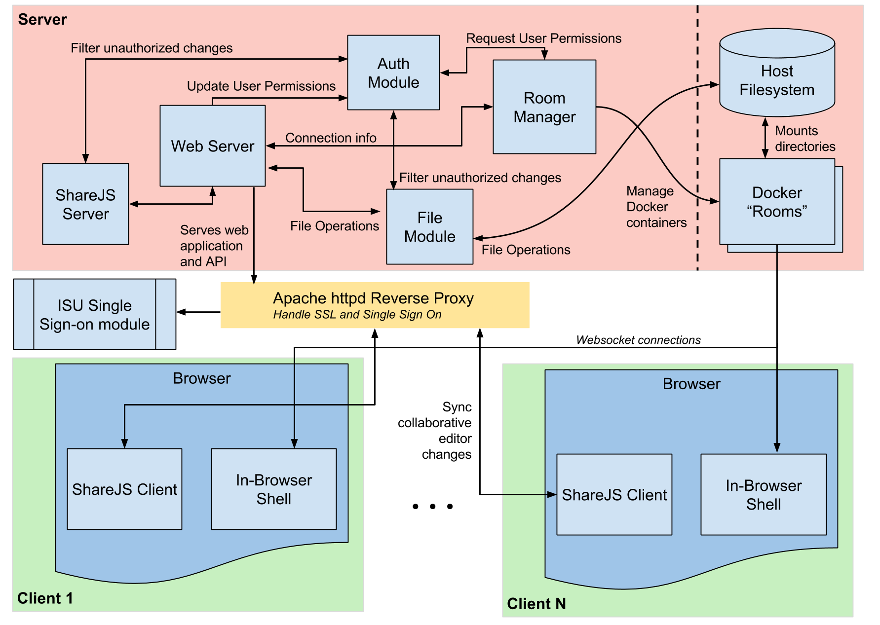
Notes:
Jake B will rock this slide
Ended up with a system that looks like this
Red is for the virtual machine
Dashed vertical line is isolated in containers
Yellow is the proxy we had to use for SSO and SSL
In green we have connected clients
Terminals are served over websocket connection from container to client browsers
Collaborative edits are served to the main web application, which interacts on the server-side with the filesystem
Authentication/authorization checks happen at a few steps along the way

Slide 21
Technical Challenges

Slide 22
Challenge 1: Certificates
Single Sign-On (SSO) requires using HTTPS on our servers
Browsers have extra security over HTTPS
So docker classrooms also had to run over HTTPS
Solution: Set-up the certificates in-memory, then delete from container
Notes:
Dan Smith
Mention the security concern of having SSL certificates loaded on the docker classroom
Docker rooms give full filesystem access to their users
Certificate
Certificates must be loaded into the classroom server for SSL connections to the shell

Slide 23
Challenge 2: Connecting the Pieces
Separate parts coded and tested in isolation
Needed to seamlessly interface
Coordinating different members’ work was challenging
Notes:
Jacob W

Slide 24
Challenge 3: Edge Cases
Testing revealed numerous edge cases that the “typical” use-case did not
Example: What happens if a user loses their connection as they are refreshing the page?
Resolve issues as they come up
Notes:
Jacob W

Slide 25
Challenge 3: Edge Cases
Several troublesome scenarios
Shell is killed
Permissions cannot be retrieved
Design such that safe state can be reached
Refresh page
Logout and re-login
Notes:
Jacob W

Slide 26
Test Plan
Every week we test new features group members have completed
We outline issues and record them in Jira
Outstanding issues are evaluated at the end of weekly meetings
Notes:
Jacob W

Slide 27
Test Space
Test space for this project is very large
Its scalability makes exhaustive testing impossible
Tested for any reasonable and unreasonable scenarios we could replicate
Most difficult scenarios involve many users
Notes:
Kyle T

Slide 28
Classroom Testing
Com S 228 Recitation
15 concurrent users
Testing Perspective
Ran into one bug
Everything else functioned properly
TA perspective
Very useful, removes “TA auto correct”
Student perspective
Interested in using again, thought it was useful
Notes:
Bryan P

Slide 29
Questions?

Slide 30
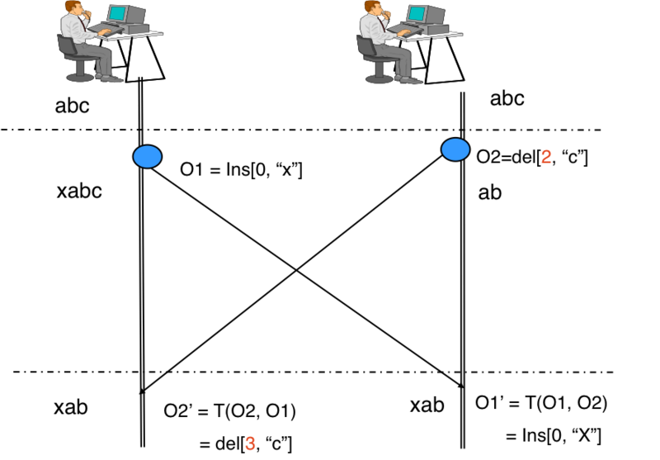
Operational
Transforms

